Slide 1
Vehicle to Infrastructure Platform Concept 29 Sep 2022

Slide 2
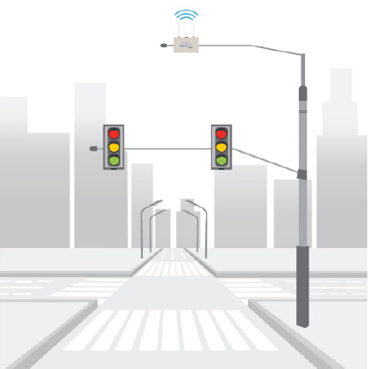

V2X Connected Intersection
TMC – Traffic Management Center
ATC – Advanced Traffic Controller
RSU – V2X Road Side Unit
OBU – V2X On Board Unit
TMC connected to city wide ATCs and RSUs
TMC configures RSUs with intersection MAP and Traveler Information Messages (TIMs) to broadcast.
ATC controls traffic light signal phase and timing (SPaT) and communicates the SPaT to RSU
RSU broadcasts SPaT, MAP, and TIMs to nearby vehicles (up to 1 km range)
RSU
OBU
ATC
TMC

Slide 3


5G Connected Intersection
vRSU – Virtual Road Side Unit
Bitbrew
vRSU
TMC configures SGW with intersection MAP and TIM messages
ATC communicates real time SPaT to Smart Gateway (SGW)
SGW communicates SPaT to the Cloud through the TMC
Cloud offers to communicate (over 5G) SPaT, MAP, and TIMs to vehicles within 1 km of the vRSU
Vehicle processes the offers and accepts to receives the data required
Smart GW
5G
ATC
TMC

Slide 4
5G Direct Connected Intersection
vRSU – Virtual Road Side Unit
Bitbrew
vRSU
TMC configures SGW with intersection MAP and TIM messages
ATC communicates real time SPaT to Smart Gateway (SGW)
SGW communicates SPaT to the Cloud using onboard LTE / 5G.
Cloud offers to communicate (over 5G) SPaT, MAP, and TIMs to vehicles within 1 km of the vRSU
Vehicle processes the offers and accepts to receives the data required
5G
Smart GW
5G
ATC

Slide 5

Hybrid Connected Intersection
Bitbrew
vRSU
RSU and vRSU simultaneously broadcast / communicate SPaT, MAP, and TIMs to vehicle OBUs in proximity to the relevant intersection
Information follows the same format setup by the V2X standards
Vehicle OBU / 5G processing of the intersection information for V2I applications remains the same, independent of the source
5G / RSU
Fiber or 5G to cloud
Smart GW
or use RSU
5G / OBU
ATC
TMC

Slide 6
V2I Platform Goals
Platform should be able to scale up efficiently and handle high numbers of RoadSideClients and UserClients (USA 300k intersections and 250M vehicles)
Data delivery with Low latency to vehicles (i.e. SPaT, others)
Data deposit and Data retrieval Communication protocol to be standardized for interoperability with other platforms or vehicle devices
Data message format to be developed in line to existing V2X standards (J2735) where possible
Flexibility to support various vehicle devices (OBU, TCU, Datalogger, mobile phone, etc.)
Flexibility to support various infrastructure equipment (SGW, RSU, ATC, others) for edge communication

Slide 7
V2I Platform Components
ATC/TMC Configuration
SGW/RSU Device Management, Configuration & Security Authentication
vRSU Configuration
UserClient Management, Configuration & Security Authentication
UserClient can be V2X_Vehicle (or) Authorized_IoT_Device [Pedestrian with Cell Phone]
UserClient Location Upload to Platform
J2735_SnapShot for V2X_Vehicle. Frequency of Upload could be proportional to Vehicle Speed.
List of PSIDs that the UserClient can support to receive and process
Platform Geo-Fencing logic
To Filter only relevant vRSU(s) based on received Location
Platform to stream J2735 Messages as per the requested PSIDs to UserClient
Platform forward vRSU(s) Data to UserClient
MAP, SPaT, TIM, PSM, RTCM, etc.
UserClient Applications
In-V2X_Vehicle can provide Red-Light Violation Warning Annunciation using MAP & SPaT Data received
In-V2X_Vehicle can place Traffic Signal Priority / Preemption to ATC through Platform / SGW
Pedestrian with Cell Phone (Authorized_IoT_Device) can report Traffic Incident

Slide 8
V2I Platform Components (contd.)
Payment / subscription services [FUTURE]
Tolling
vRSU Applications & Advisories Download to Vehicles [FUTURE]
Road Weather Applications (Cloud Based ICE Warning)

Slide 9

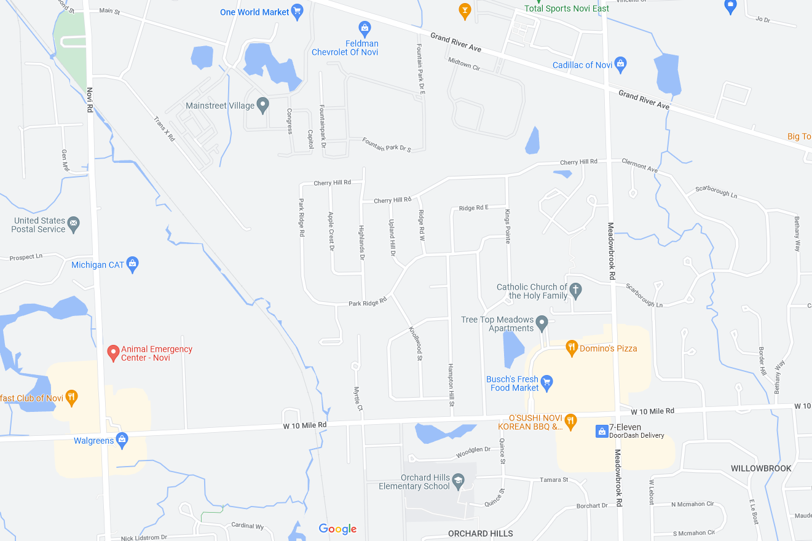


Concept Diagram
MY “NEW” POSITION
MY POSITION
DATA FROM
RSC #1
DATA FROM
RSC #2 & RSC #3
RSU
Cloud
Platform
RoadSideClient #3
RoadSideClient #4
Construction Zone TIM #1
RoadSideClient #5
Construction Zone TIM #2
RSU
Smart GW
RoadSideClient #2
RoadSideClient #1

Slide 10
V2X Platform Data Parameters
Vehicle position upload to Platform:
less than 50 kph [every 5s]
greater than 50 kph [every 1s]
Geofencing RSCs based on distance threshold:
Vehicle speed less than 50 kph [300 m radius]
Vehicle speed greater than 50 kph [1000 m radius]
MAP and TIM messages Frequency
Send only once (or) When payload changes
SPaT
Send new payload only when Any PHASE has a state (or) timing change
Note: Intention is to keep data content low for cellular cost efficiency.

Slide 11
Why MQTT for Communication Protocol?
Light weight compared to HTTPS / REST API
Ideal for applications where the same payload is delivered to multiple clients
Supports TLS 1.2 which can help with:
Client Authentication
Encrypted Data exchange.
Existing real-world deployment (GNSS Correction services)
GPS Correction data as of today is delivered to highly accurate GNSS receivers through the cloud.
The Correction data might vary based on location of the GNSS receiver but all receivers in that locality will all receive the same data
MQTT is used for this application which is very similar to V2X_Platform concept.

Slide 12
MQTT Implementation Guide for V2X_Platform Concept
This presentation covers MQTT requirements of the V2X_Platform Concept
Topics Tree to be used by MQTT Client(s)
MQTT Payload definition
MQTT Configuration options

Slide 13
Topics Tree
{Payload Directionality} /{ID}/{Message Category}/
1st level topic : Payload Directionality
RoadSideClientToPlatform – Used when SGW / RSU is publishing data to the Platform
PlatformToUserClient – Used when UserClient subscribes to Data from the Platform
UserClientToPlatform – Used when UserClient publishes Data to the Platform
2nd level topic : ID
RSC_id – Unique Identifier for each RoadSide Client (SGW, RSU, Road Construction Worker, etc. )
UC_id – Unique Identifier for each User Client
3rd level topic : Message Category
MAP – Used when RSC wants to publish MAP Data to Platform
SPaT – Used when RSC wants to publish SPaT Data to Platform
TIM – Used when RSC wants to publish TIM Data to Platform
SubscribedPayload – Used when UC subscribes to data.
UserClientUpload – Used when UC subscribes to data.
3rd Level Topic could be expanded in the future to accommodate for more messages like: PSM, RTCM, etc.

Slide 14



RoadSideClient -> Platform
PUBLISH
SUBSCRIBE
MQTT Broker
RoadSide
Client #1
Platform
/RoadSideClientToPlatform/RSC_id/MAP
/RoadSideClientToPlatform/*
/RoadSideClientToPlatform/RSC_id/SPaT
RoadSideClient -> Platform [PUBLISH]
topicName | /RoadSideClientToPlatform/RSC_id/MAP
qos | 1
retaingFlag | false
payload | ASN.1 Encoded UPER Payload of MAP (or) SPaT (or) TIM Message
dupFlag | false
PUBLISH
RoadSide
Client #2
/RoadSideClientToPlatform/RSC_id/MAP
/RoadSideClientToPlatform/RSC_id/SPaT
xyz – To be finalized
xyz – Could be MAP, SPaT (or) TIM

Slide 15
UserClient -> Platform
PUBLISH
SUBSCRIBE
UserClient #1
MQTT Broker
/UserClientToPlatform/UC_id/UserClientUpload
Platform
/UserClientToPlatform/*
UserClient #2
/UserClientToPlatform/UC_id/UserClientUpload
PUBLISH
UserClient -> Platform [PUBLISH]
topicName | /UserClientToPlatform/UC_id/UserClientUpload
qos | 1
retaingFlag | false
payload | ASN.1 Encoded UPER Payload of UserClientUpload Message
dupFlag | false
xyz – To be finalized

Slide 16
Platform -> UserClient
SUBSCRIBE
PUBLISH
MQTT Broker
Platform
UserClient #1
/PlatformToUserClient/UC_id/SubscribedPayload
/PlatformToUserClient/UC_id/SubscribedPayload
PUBLISH
UserClient #2
/PlatformToUserClient/UC_id/SubscribedPayload
SUBSCRIBE
/PlatformToUserClient/UC_id/SubscribedPayload
Platform -> UserClient [PUBLISH]
topicName | /PlatformToUserClient/UC_id/SubscribedPayload
qos | 1
retaingFlag | false
payload | ASN.1 Encoded UPER Payload of MAP (or) SPaT (or) TIM Message from all RSCs that satisfy the Geo-Fencing Logic
dupFlag | false
xyz – To be finalized

Slide 17
Sequence Diagram

Slide 18
MQTT Payload definition [UserClientUpload]
UserClientUpload ::= SEQUENCE {
positionUpload PositionUpload,
supportedServicesUpload SequenceOfPsid,
extendedUpload ExtendedUpload OPTIONAL,
...
}
SequenceOfPsid ::= SEQUENCE OF Psid
Psid ::= INTEGER (0..MAX)
PositionUpload
Contains information about geo-location of the UserClient
SEQUENCE of Psid
OPTIONAL
UserClient can upload list of PSIDs the UserClient is interested to receive from Platform
To be uploaded once per ignition cycle. Can be ignored afterwards.
Example:
0x20-40-97 = MAP Distribution
0x82 = Intersection Safety Awareness (SPaT)
ExtendedUpload
OPTIONAL
UserClient can upload extended information to Platform that cannot be covered in positionUpload
Example : SRM, RWM, etc
PSIDs from https://standards.ieee.org/products-programs/regauth/psid/public/

Slide 19
MQTT Payload definition [PositionUpload]
PositionUpload ::= SEQUENCE (SIZE(1..32)) OF SnapShot
PositionUpload => SEQUENCE of SnapShot
BSM has no sense of exact UTC Minute, Hour, Day, etc. It only has Dsecond of the current minute.
SnapShot has full UTC Date + TimeStamp.
Snapshot also has PathHistory + PathPrediction.
This is useful for Platform to accept / reject packets with high latency.
PositionUpload is given the capability to upload sequence of Snapshots since it might have that processing power and capability.

Slide 20
MQTT Payload definition [ExtendedUpload]
ExtendedUpload ::= CHOICE {
priorityRequestUpload SignalRequestMessage,
preemptionRequestUpload SignalRequestMessage,
...
}
priorityRequestUpload => SignalRequestMessage
Based on vehicle role, UserClient can place a Priority Signal Request Message to Platform
Example: SnowPlows, TransitBuses, etc.
SignalRequestMessage->SignalRequestList has the capability to hold multiple requests for different intersections
preemptionRequestUpload => SignalRequestMessage
Based on vehicle role, UserClient can place a Preemption Signal Request Message to Platform
Example: PoliceCars, FireTrucks, etc.
SignalRequestMessage->SignalRequestList has the capability to hold multiple requests for different intersections

Slide 21
TMC Configuration
If traffic is going to be routed through TMC,
Establish outbound path for SGW/RSU to Platform (IPv4 and IPv6)
Work with relevant DOT to Whitelist the Platform in TMC
Produce Security requirements to authenticate and verify identity of each SGW/RSU talking to Platform

Slide 22
SGW/RSU Device Management, Configuration & Security
Geo-Location Configuration
Network configuration to communicate with ATC for SPaT
Security Enrollment to authenticate Identity of SGW/RSU communicating to Platform.
Use HTTPS with TLS to implement:
Client Authentication
Encrypted Data download from Platform.
SGW should be able to take MAP Message as an Input Configuration
MAP Message is a UPER Encoded Hex Stream of Bytes as per J2735.
IntersectionID derived from MAP Message
SGW will need to have to capability to decode Encoded Hex Payload.
Should support multiple ATC Supplier Data Formats
Trafficware, D4, Econolite, Siemens, McCain, RSU 4.1 Active Message, etc.
OTA device updates to SGW/RSU
SoH monitoring
For Signal Priority / Preemption [FUTURE]
SmartGW should have a configurable Lookup Tables.
Phase Number | Priority Number in TC
Phase Number | Preemption Number in TC

Slide 23
UserClient Device Management, Configuration & Security
Security Enrollment to authenticate Identity of SGW/RSU communicating to Platform.
Use HTTPS with TLS to implement:
Client Authentication
Encrypted Data download from Platform.
OTA device updates to SGW/RSU
SoH monitoring

Slide 24
vRSU Configuration
Each VGW/RSU connecting to Platform is a vRSU Node on the Platform
Each vRSU node on the network should be able to offer multiple services
MAP Distribution
SPaT Distribution
RTCM Distribution
Pedestrian Detection / PSM Distribution
Signal Priority / Preemption

Slide 25
UserClient Data Upload
If UserClient is a V2X_Vehicle,
Uploads the below message to Platform:
UserClientPlatformMessage
positionUpload
vehiclePositionUpload
Frequency of Upload should be proportional to Vehicle Speed.
First time a UserClient connects to platform, “supportedServicesUpload” should be populated
If UserClient is an Authorized_IoT_Device [Pedestrian with Cell Phone],
Uploads the below message to Platform:
UserClientPlatformMessage
positionUpload
nonVehiclePositionUpload
First time a UserClient connects to platform, “supportedServicesUpload” should be populated

Slide 26
Platform Geo-fencing relevant vRSUs & Data Stream
Using the Geo-Location, Speed and Heading from the uploaded data from UserClient,
Platform to apply a Geofence around the received Location data and pick out the relevant vRSU Nodes.
Platform to also parse the requested PSIDs from the UserClient
Platform to stream all applicable PSID data from the list of relevant vRSUs to UserClient
The Geo-Fencing Logic will have to be dynamic based on the proximity of vRSUs to each other in an area.
Very dense areas (Example: Manhattan) the applicable vRSUs will be:
2 Ahead in travel direction
1 Left Ahead
1 Right Ahead
1 Behind
Mild dense areas (Example: Novi) the applicable vRSUs will be:
2 Ahead in travel direction
1 Behind
Sparse Areas (Example: Highways) the applicable vRSUs will be:
1 Ahead in travel direction

Slide 27
UserClient Applications and Advisories Annunciation to Driver
Same as V2X OBU, all platform communicated data evaluated along with vehicle path to determine driver advisories and warnings

Slide 28
Payment / subscription services
Method to pay for platform services during enrollment of vehicle devices.
May have to pay the DOTs for access to the ATC data

Slide 29
vRSU Applications & Advisories Download to Vehicles
Any platform vRSU based applications data or advisories
Intersection sensor detection of environment:
Pedestrian presence
Vulnerable road user presence
Vehicle presence (especially intersecting path vehicles)

Slide 30
To do List
Produce Security Requirements to implement:
UserClient Identity Authentication
vRSU Identity Authentication
Define Periodicity of Messages being published to Platform
Investigate Scope for reducing periodicity

Slide 31
UserClient Phone App - Reqs
Phone Application to
Connect to MQTT Broker over LTE / Wifi of the phone.
Publish location over MQTT:
ASN.1 UPER Encode Payload and then publish
Subscribe to data over MQTT:
Perform ASN.1 UPER Decode of MAP, SPaT and TIM
Push Decoded MAP, SPaT and TIM and Location to “MINIMAL ALGO”
Intersection Manager, Lane Finder, etc.
MINIMAL ALGO shall output:
Counter of received messages (MAP, SPaT, PSM, TIM) over MQTT
Current Signal Phase Light Status and Timing information.
Example: (RED – 31.3 seconds)
ALGO Output shall be displayed:
On the Phone App itself.
Or on CarPlay

